Slide 1
BUSINESS COMMUNICATION-I
LECTURE No. 3
Opening and Closing

Slide 2
The Opening and Closing
The opening and closing paragraph are the most important part of the body of the letter or any other message. They are discussed in detail below:

Slide 3
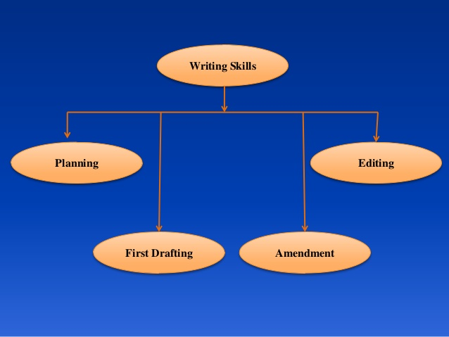

Slide 4
THE OPENING

Slide 5
Opening of a letter is very important because first impression is the last impression. The opening may determine whether the reader continues reading puts the message aside for lather study, or discards it. The first paragraph should preferably:
Be reader centered
Make a favorable (positive) impression , and
Orient the reader to the subject and purpose of the message.

Slide 6
Some Suggestions for Good Opening:

Slide 7
Get the reader into the picture. Emphasize (highlight) on you
Begin (start) directly with the subject
Use a buffer (barrier) when you must refuse the reader. Don’t spread gloom (darkness) with your first words; at least get in step.
In a persuasive (convincing) request (like sales letter), get the reader’s attention by following the principles of AIDA, It stands for Attention (notice), Interest, Desire (wish), and Action.
Be positive. Talk about the pleasant (attractive) / satisfying not the un-pleasant (un-attractive).

Slide 8
6. Keep the first sentences and the first paragraph relatively short. (17 to 25 words, 5-6 lines).
7. Use a theme (matter) opening (if desirable / attractive) apply 5 W’s Who, What, When, Where, and Why.
8. Avoid the beginning with the repetition of things they wrote you.
9. Avoid worn out beginnings. Use conversational (spoken) words.
10. Avoid an offending (wrong) opening.
11. Mention the date of the letter you are answering.
12. Make sure the opening sentence is complete and proper.

Slide 9
THE CLOSING

Slide 10
The closing play a very important role in motivating reader to act as desired provided it is appropriately (properly) written.
We remember best what we real last. In the closing we want to bring the desired action.
“Last impression is the pasting impression”.

Slide 11
Guidelines for Closing:
If you want your reader to act as you desire, ask for action explicitly (unmistakably) and clearly.
Make action easy by giving phone numbers or by sending stamped envelope.
The closing note should be positive. Negative ending weakens your presentation.
Show friendly attitude (emotion) to enhance (build up) the good will of the firm, and to improve the opportunity of getting desired response.

Slide 12
Guidelines for Closing:
5. Don’t thank in advance because this act in un-necessary and illogical and does not help the least to bring desired results.
6. If necessary include a final “blow” line to strengthen (maintain) your message. You may enclose a booklet, pamphlet to give more details.
7. On certain occasions you may wish to connote (show) a personal touch.
8. Don’t write worn out and out dated terms, such as enclosed herewith, as soon as possible, I remain, obediently, thanking you, thanking you in anticipation (expectation), and the likes.
These expressions create monotony (repetitiveness) and do not leave pleasant (satisfying) impression on the reader.

